Slide 1

Basic Details of the Team and Problem Statement
Organization Name: National Digital Education Architecture
(NDEAR), Department of School Education & Literacy (DoSEL).
PS Code: AK1095
Problem Statement Title: Bringing power of AI/ML to aid of
teacher in a classroom
Team Name: Code-18.
Team Leader Name: Lokesh E. Institute Code (AISHE): C-1336.
Institute Name: BMSIT&M.
Theme Name: SMART AUTOMATION.

Slide 2
Sahayta
Using OCR/OMR for Automating Records

Slide 3
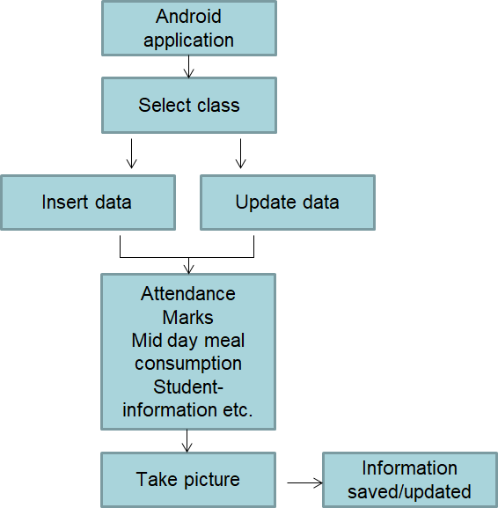
Idea/Approach Details
Describe your idea/Solution/Prototype here:
Introducing an android application that with the use of OCR and OMR technology converts data (handwritten marks, attendance, students info, etc..) into editable format and saves it to google sheets/drive.
The converted data is used to calculate avg marks,
attendance percentage, mid-day meal consumption, etc., and
to store information in a drive/sheets automatically.
Describe your Technology stack here:
Flutter
VS Code
OMR/OCR technology
Firebase ML Kit
Stored information of students can be accessed and updated
by teachers anytime using the same android application.
2

Slide 4
Idea/Approach Details
Describe your Use Cases here
Describe your Dependencies / Show stopper here
Teachers will take pictures of the data written in the templates.
They will select the data type (Marks, attendance, Aadhar and PAN details, students list, etc.)
Information will be stored in the drive and teachers can download the pdf of the data stored.
They can update existing data, insert a new element to data at any instant.
Can generate e-marks cards, attendance percentage, the academic performance of individual students or overall class students and save/download in pdf format in the drive.
Teachers can only convert handwritten data to editable text only when they wrote data in a particular predefined template.
3

Slide 5
Team Member Details
Team Leader Name:
Branch : Btech
Team Member 1 Name:
Branch : Btech
Team Member 2 Name: Branch : Btech Team Member 3 Name: Branch : Btech Team Member 4 Name: Branch : Btech
Team Member 5 Name:
Branch : Btech
Lokesh E
Stream : ISE
Year : II
Prerna Shankar
Stream : ISE
Year : II
Jitendriyadeep
Stream : ISE
Year : II
Monish S
Stream : ISE
Murali Manohara Hegde A S
Stream : ISE
Pranav Aditya
Stream : ISE
Year : II
Year : II
Year : II
Team Mentor 1 Name: Mr. Gireesh Babu CN
Category (Academic/Industry): Academic
Expertise (AI/ML/Blockchain etc): AI / ML
Domain Experience (in years):10 years

